Slide 1
Section 9.3
Infinite Series

Slide 2
All graphics are attributed to:
Calculus,10/E by Howard Anton, Irl Bivens, and Stephen Davis Copyright © 2009 by John Wiley & Sons, Inc. All rights reserved.”

Slide 3
Introduction
The purpose of this section is to discuss sums that contain infinitely many terms. The most familiar examples of such sums occur in the decimal representations or real numbers. For example, when we write $\frac{1}{3}$ in the decimal form $\frac{1}{3}$ = 0.33333… we mean
$\frac{1}{3}$ = 0.3 + 0.03 + 0.003 + 0.0003 + … which suggests that the decimal representation of $\frac{1}{3}$ can
be viewed as a sum of infinitely many real numbers.

Slide 4
Sums of Infinite Series - Definition

Slide 5
Sums of Infinite Series - example
$\frac{1}{3}$ = 0.3333… = 0.3 + 0.03 + 0.003 + 0.0003 + …
= $\frac{3}{10}$ + $\frac{3}{{10}^{2}}$ + $\frac{3}{{10}^{3}}$ + $\frac{3}{{10}^{4}}$ + …
If we break this up into finite sums, it looks like:
$s_{1}$ (first sum) = $\frac{3}{10}$ = 0.3
$s_{2}$ (second sum) = $\frac{3}{10}$ + $\frac{3}{{10}^{2}}$= 0.33
$s_{3}$ (third sum) = $\frac{3}{10}$ + $\frac{3}{{10}^{2}}$+ $\frac{3}{{10}^{3}}$ = 0.333
$s_{4}$ (fourth sum) = $\frac{3}{10}$ + $\frac{3}{{10}^{2}}$+ $\frac{3}{{10}^{3}}$ + $\frac{3}{{10}^{4}}$ = 0.3333 etc.
These approximations to the “sum” of the infinite series will get closer and closer to $\frac{1}{3}$ as we add more terms.
This suggests that the desired sum of $\frac{1}{3}$ might be the limit of this sequence of approximations:
$s_{n}$ (nth sum) = $\frac{3}{10}$ + $\frac{3}{{10}^{2}}$+ $\frac{3}{{10}^{3}}$ +… $\frac{3}{{10}^{n}}$

Slide 6
Sums of Infinite Series as a Limit
We need to calculate the limit:
$\lim_{n→+∞}{s_{n}}$ = $\lim_{n→+∞}(\frac{3}{10}$ + $\frac{3}{{10}^{2}}$+ $\frac{3}{{10}^{3}}$ +… $\frac{3}{{10}^{n}}$)
Since it is difficult to do in this form, we need to manipulate and rewrite the sum first.
$\frac{1}{10}∗$ $s_{n}$= $(\frac{3}{10}$ + $\frac{3}{{10}^{2}}$+ $\frac{3}{{10}^{3}}$ +… $\frac{3}{{10}^{n}}$)*$\frac{1}{10}$ multiply both sides by 1/10
If we distribute and subtract the previous line from the nth sum, we get a closed form where the number of terms does not vary with n.
$s_{n}$ - $\frac{1}{10}$ $s_{n}$ = $\frac{3}{10}$ + $\frac{3}{{10}^{2}}$+ $\frac{3}{{10}^{3}}$ +… $\frac{3}{{10}^{n}}$ - $(\frac{3}{10}$ + $\frac{3}{{10}^{2}}$+ $\frac{3}{{10}^{3}}$ +… $\frac{3}{{10}^{n}}$)*$\frac{1}{10}$
$\frac{9}{10}$ $s_{n}$ = $\frac{3}{10}$ + $\frac{3}{{10}^{2}}$+ $\frac{3}{{10}^{3}}$ +… $\frac{3}{{10}^{n}}$ - $\frac{3}{{10}^{2}}−$ $\frac{3}{{10}^{3}}$ …- $\frac{3}{{10}^{n}}−$ $\frac{3}{{10}^{n+1}}$ = $\frac{3}{10}$ - $\frac{3}{{10}^{n+1}}$
$\frac{9}{10}$ $s_{n}$ = $\frac{3}{10}$(1- $\frac{1}{{10}^{n}}$)
$\frac{10}{9}∗\frac{9}{10}$ $s_{n}$ = $\frac{10}{9}∗ \frac{3}{10}$(1- $\frac{1}{{10}^{n}}$) multiply both sides by 10/9
$s_{n}$ = $\frac{1}{3}$(1- $\frac{1}{{10}^{n}}$) which we can finally take the limit of
$\lim_{n→+∞}{s_{n}}$ = $\lim_{n→+∞}\frac{1}{3}\text{(}\text{1- }\frac{1}{{10}^{n}}\text{)}$ = $\frac{1}{3}$(1- $0$) = $\frac{1}{3}$ YEAH!

Slide 7
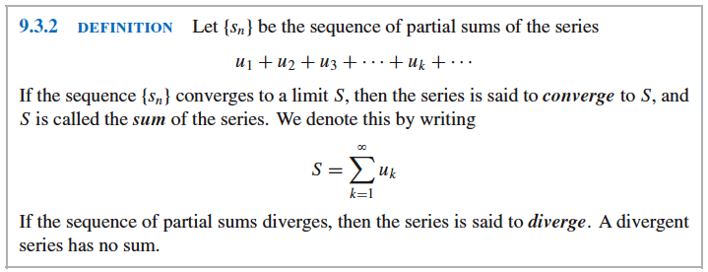
Formal Definition
The number $s_{n}$ is called the nth partial sum of the series and the sequence $\left\{s_{n}\right\}$_{n=1}⁺$∞$ is called the sequence of partial sums.
As n increases, the partial sum $s_{n}$ = $u_{1}$ + $u_{2}$ +… + $u_{n}$ includes more and more terms of the series.

Slide 8
Geometric Series
As you probably remember from Algebra II, Geometric Series are series in which each term is obtained by multiplying the preceding term by some fixed constant (r = common ratio).
Sometimes it is desirable to start the index of summation of an infinite series at k = 0 rater than k = 1 like they do in the theorem below:

Slide 9
Starting at k = 0 vs k = 1
If we start the index of summation at k = 0, $u_{0}$ would be called the zeroth term and $s_{0}$ = $u_{0}$ would be called the zeroth partial sum.
It can be proven that changing the starting value for the index of summation of an infinite series has no effect on the convergence, the divergence, or the sum.
The difference for the geometric series would be $\sum_{k=1}^{+∞}{ar^{n−1}}$
The proof of Theorem 9.3.3 and, hence, the series on the previous line is on page 618 and is very similar to the work on slide #6.

Slide 10
Example of Geometric Series
Determine whether the series $\sum_{k=1}^{+∞}{3^{2k}5^{1−k}}$ converges, and if so find its sum.
Solution:
This is a geometric series in concealed form, since we can rewrite it.
$\sum_{k=1}^{+∞}{{(3}^{2k})5^{−1(k−1)}}$ = $\sum_{k=1}^{+∞}{\frac{{(3^{2})}^{k}}{5^{(k−1)}}}$ = $\sum_{k=1}^{+∞}{\frac{{(9)}^{k}}{5^{(k−1)}}}$
$\sum_{k=1}^{+∞}{9\frac{{(9)}^{k−1}}{5^{(k−1)}}}$ = $\sum_{k=1}^{+∞}{9{\left(\frac{9}{5}\right)}^{k−1}}$
Where r = $\frac{9}{5}$ > 1 and therefore diverges.

Slide 11
Example
Determine whether the series 1 -1 + 1 – 1 + 1 – 1 + … converges or diverges. If it converges, find the sum.
Solution:
It seems like it should have a sum of zero since the positives and negatives could cancel one another. However, this is NOT CORRECT.
Start with the partial sums.
$s_{1}$ (first sum) = $1$
$s_{2}$ (second sum) = $1 −1=0$
$s_{3}$ (third sum) = $1 −1+1=1$
$s_{4}$ (fourth sum) = $1 −1+1 −1$ etc.
Thus, the sequence of partial sums is 1, 0, 1, 0, 1, 0, … which diverges.
Therefore, the given series diverges and has no sum.

Slide 12
Rational Number Example
Find the rational number represented by the repeating decimal 0.784784784…
Solution:
0.784784784…=0.784 + 0.000784 + 0.000000784+…
Therefore, the given decimal is the sum of a geometric series with a = 0.784 and r = 0.001.
When the sum formula is applied, we get 0.784784784… = $\frac{a}{1−r}$ = $\frac{.784}{1−.001}$ = $\frac{784}{999}$

Slide 13
Example Finding Values for Which a Series Converges

Slide 14
Telescoping Sums
A telescoping sum is a sum in which simplifying the sum leads to one term in each set of parentheses canceling out a term in the next set of parentheses until the entire sum “collapses” (like a folding telescope) into just two terms.
See example 5 on page 619

Slide 15
Harmonic Series
No more time today. ☹
We will go over these on Thursday because they are very important. If you are dying to finish your notes now, they are on page 620.

Slide 16
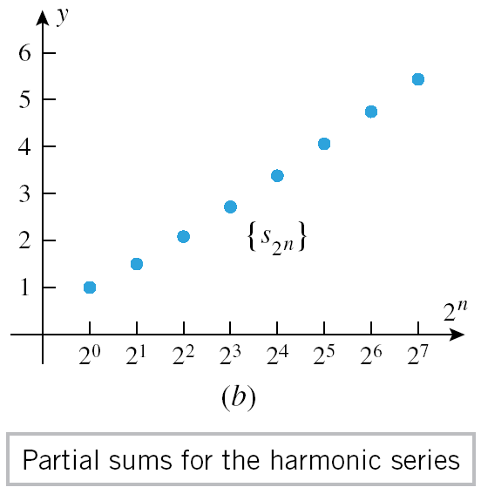
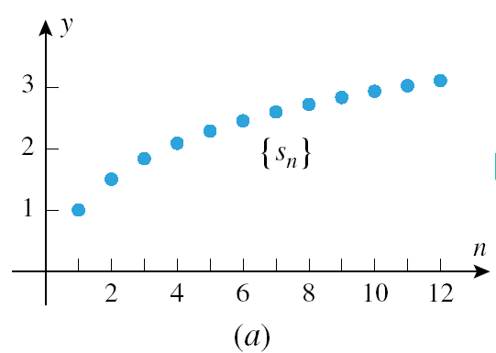
wegsd

Slide 17
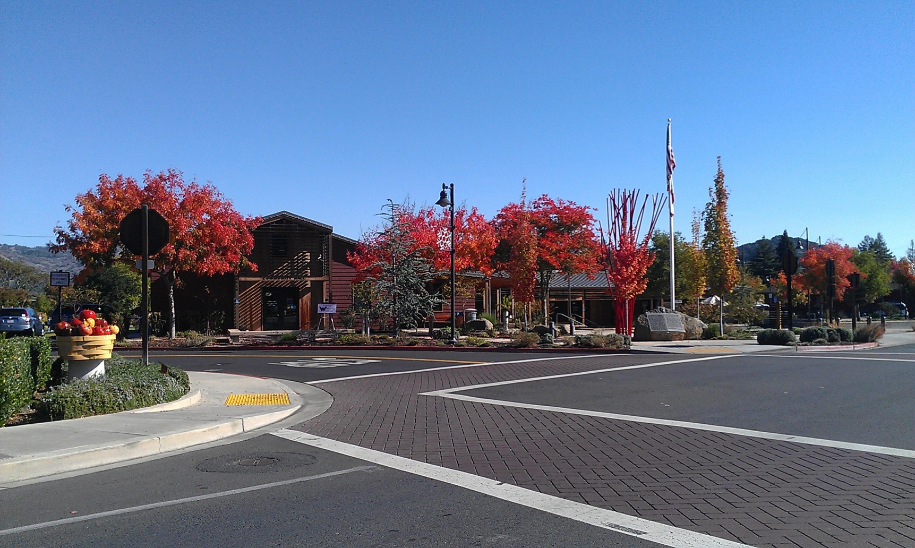
Beautiful Fall Colors Near Napa

